Slide 1
Major infections

Slide 2
We frequently receive questions about infections. The most frequently one asked is, what about an ongoing infection? How do I enter a patient that has an ongoing infection? Within the FAQ Document we have guidelines to help in data entry in regard to different infection scenarios.

Slide 3
Pre-implant infections
If an infection was present pre-implant, it will not be counted as an infection adverse event unless the infection was treated and cleared and then recurs at a later time after implant.

Slide 4
Pre-implant infections
Case Study
75 yo female with NICM/ICM, HTN, COPD and a-fib. She has a foley catheter in place and develops a UTI 5 days prior to LVAD implant. A urine sample was sent to the lab for culture.
The culture comes back positive for Klebsiella, and she is treated with PO Bactrim for 10 days.

Slide 5
Pre-implant infections
Would this be entered in the database a Major Infection AE?
No, this was a preimplant infection.

Slide 6
Colonization
If a patient is colonized as identified by screening cultures (ex. VRE, MRSA screenings, asymptomatic bacteruria), but is asymptomatic and is not being treated for the infection, do not count it as an infection adverse event.

Slide 7
Colonization
Case Study
52 yo male with a HM3 in place is admitted to the CICU with a new onset of a-fib. Upon admission the patient had his nares swabbed for MRSA. 3 days later that nasal swab came back positive for MRSA.

Slide 8
Colonization
Would the positive nasal swab be entered into the database as Major Infection AE?
No, the patient was asymptomatic and was not treated.

Slide 9
Multiple organisms
If multiple organisms are identified on cultures form different sources all within the same 1-2 days, if it is the same type of organism (ex. All are different types of bacteria), this may be counted as one bacterial infection and for location of infection select all the locations that apply.
However, if there are different types of infection identified (ex. One bacterial and one fungal), a separate infection for each type will need to be entered, and you would select all the location that were positive for the fungal culture as one infection and all the sites that had a bacterial cultural positive for the other infection.

Slide 10
Multiple organisms
Case Study
68 yo male with a HM3 in place is admitted to the CICU with SOB, fever X3 days, a productive cough with green mucus, and milky/tan drainage from driveline site. A chest x-ray was obtained, a swab from the driveline site was sent for culture as well as a sputum sample.
The sputum sample came back positive for streptococcus and the swab from the driveline site returned positive for klebsiella. The patient was treated with IV Clindamycin and Cefazolin.

Slide 11
Multiple organisms
Would both these positive results be entered into the database as Major Infections?
Yes.

Slide 12
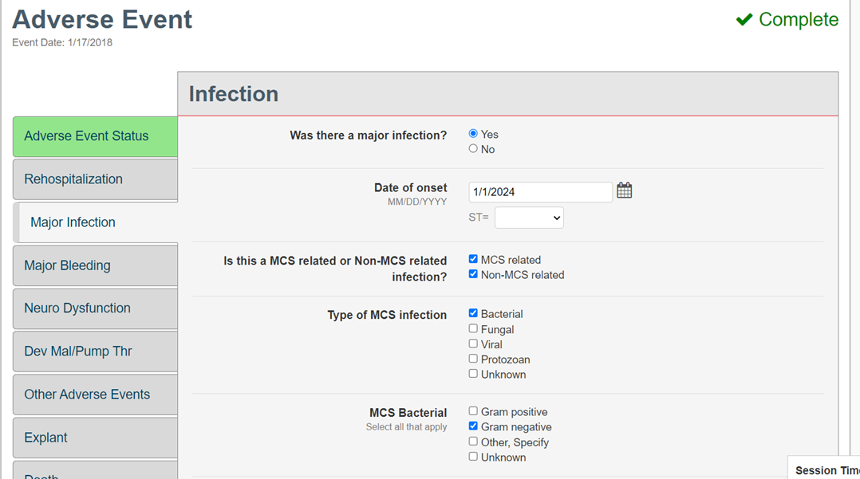
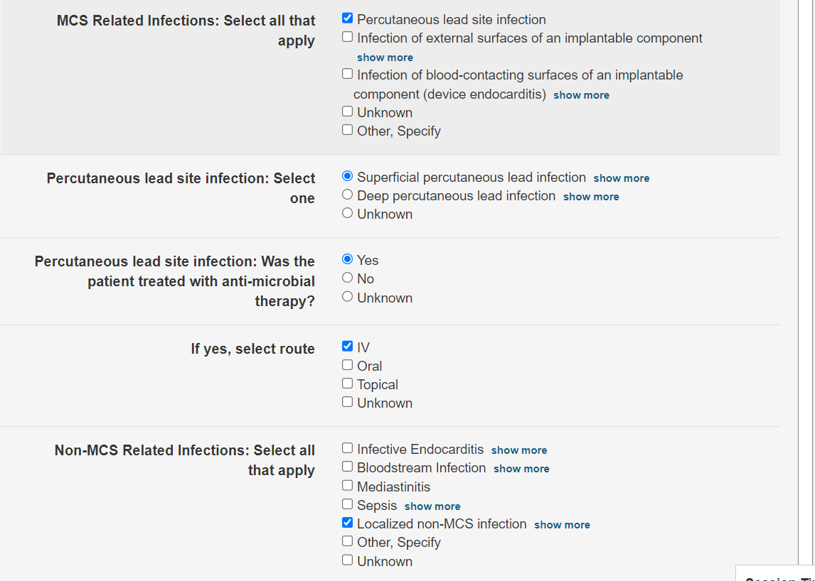
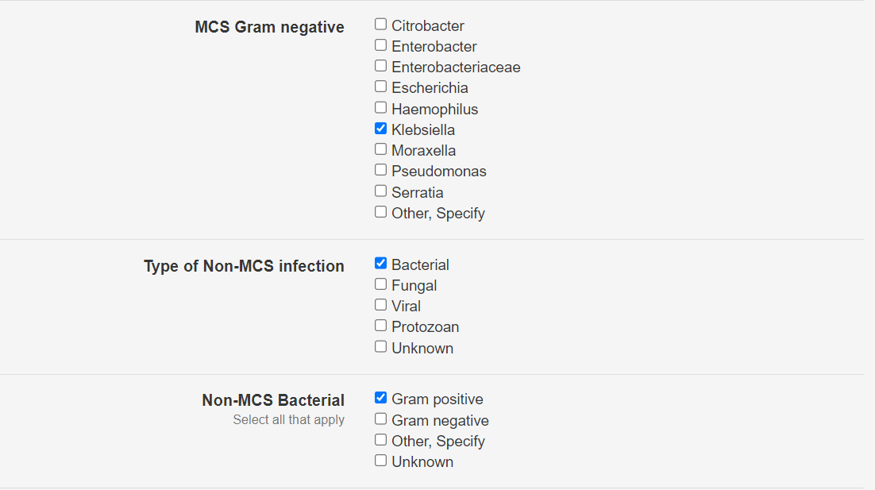
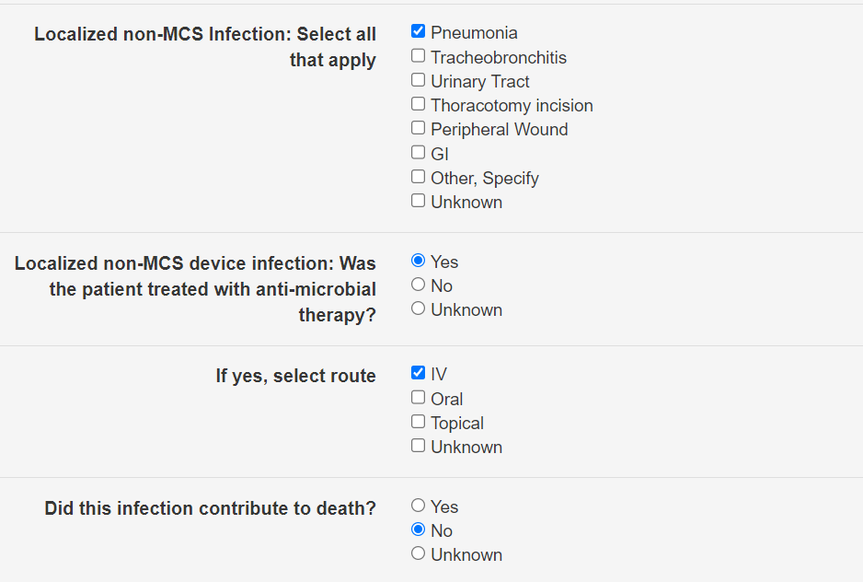

Slide 13
Ongoing infections
If there is an ongoing infection in the same location with the same type of bacteria, enter the infection when it is first identified along with what type of treatment.
If the intervention documented when the first infection is entered changes (ex. Go from oral or topical to IV antibiotics or surgery is needed), then enter another infection adverse event to document the change in intervention.
Once the change in intervention is documented, there is no need to enter the infection again unless the infection is treated and cleared and then reoccurs.
So if multiple debridements are needed and the infection has already been entered with surgery as an intervention, there is no need to enter a new adverse event for each debridement.

Slide 14
Ongoing infections
Case Study
72 yo female with a HM3 in place is in admitted in January of 2024 with increased driveline redness and is tender to touch. A swab of the driveline was sent to the lab.
The culture resulted as Staphylococcus epidermidis (MRSE). Antibiotics were initiated as PO Doxycycline.

Slide 15
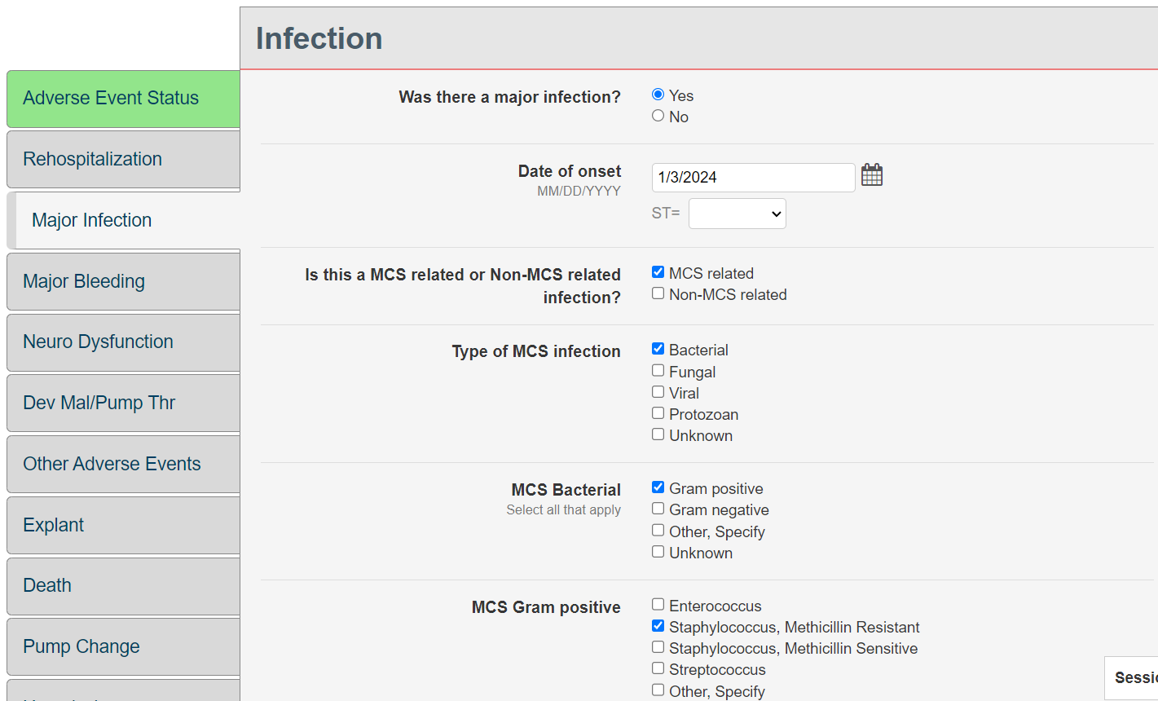
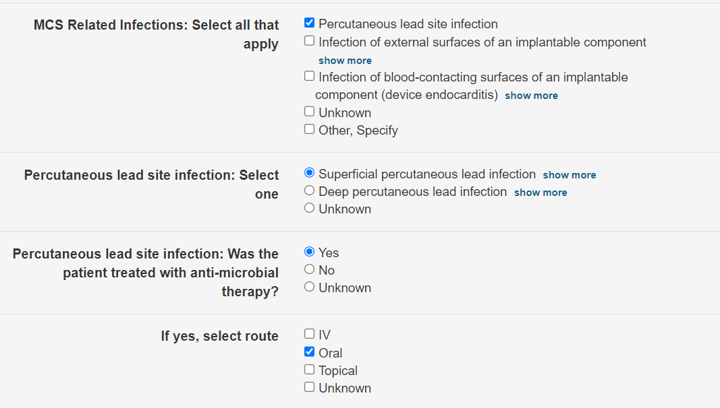
Ongoing infections
Would this positive culture be entered as a
Major Infection AE?
Yes.

Slide 16
Ongoing infections
Subsequent infection: In February the patient again returns with increased driveline drainage that is now requiring dressing changes 2-3 times per day. A swab of the driveline was sent to the lab.
The culture resulted in a positive culture of Staphylococcus Coagulase. The patient was started on IV Vancomycin.

Slide 17
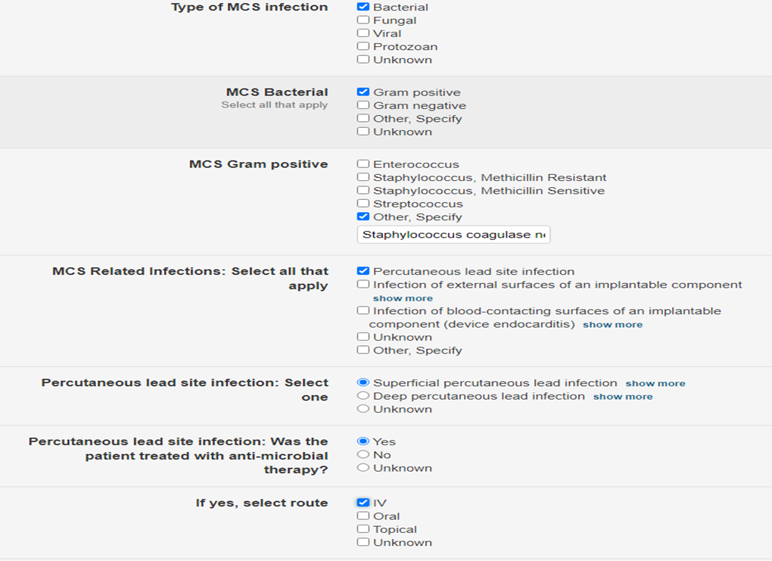
Ongoing infections
Would this second positive culture be entered as a Major Infection AE?
Yes.

Slide 18
Can you have an infection adverse event without any positive cultures?
Yes, but only if the clinical evidence is strong enough.
If the patient is having fevers, has a productive cough, chest consolidations on imaging, and is being treated for pneumonia (as noted in progress notes or I.D. consult notes) even if cultures have been unrevealing, then the clinical evidence would be strong enough for an infection: pulmonary adverse event.

